Slide 1
Danone Nations Cup
2018 national tournament

Slide 2
DNC Hungary 2017

Slide 3
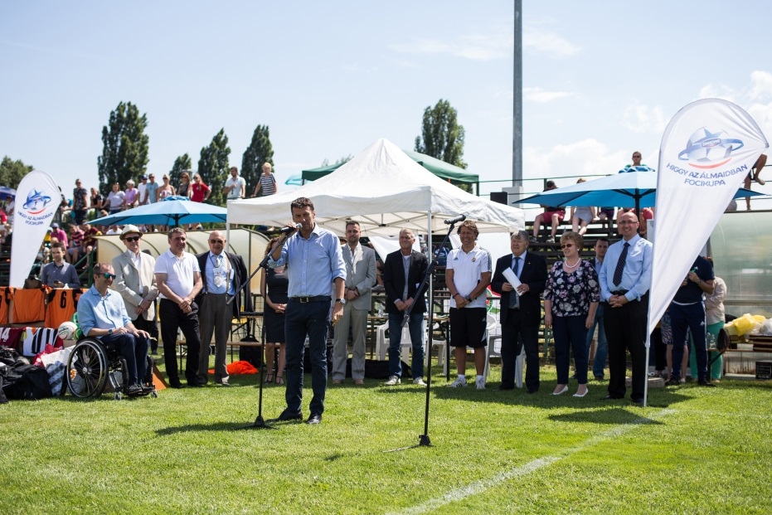
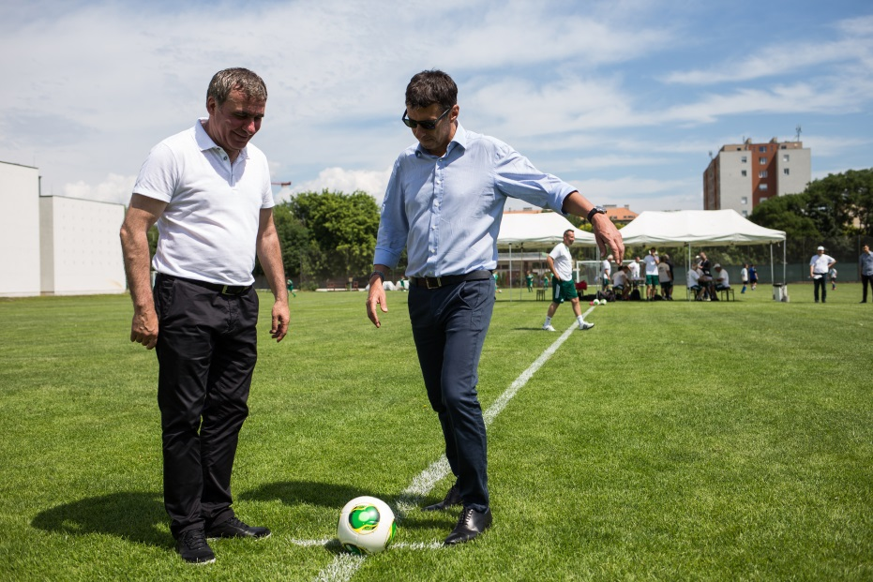
Hungarian National Tournament 2017
Cooperation with MLSZ (Hungarian Football Federation)
As part of the cooperation, we organized a national, U12 tournament with the following structure
Regional semi-finals:
12 regional semi-finals
8 teams / region
Media events in the 5 TEGY cities
Press release in 7 other regions
National final:
One day tournament with 12 teams in Budapest,
Participants:
Ministry of Human Capacities
Hungarian Dietetic Association
French Embassy
Hungarian-French Chamber of Commerce and Industry
National Federation of Food Processing Companies
Advertising Self Regulatory Board
Gheorghe Hagi "The Maradona of the Carpathians"
Media appearances:
417 pieces
42 National & regional print media
56 National & regional electronic media
319 Online

Slide 4
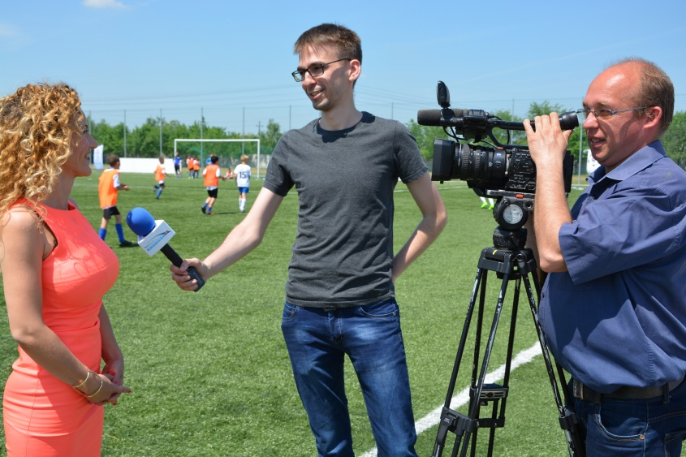
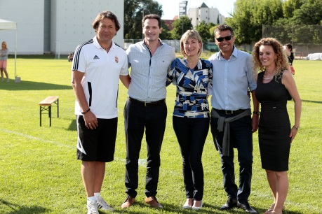
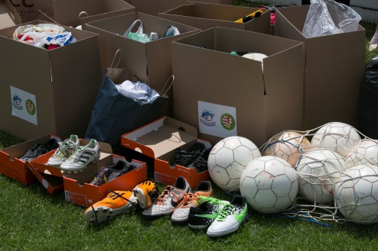
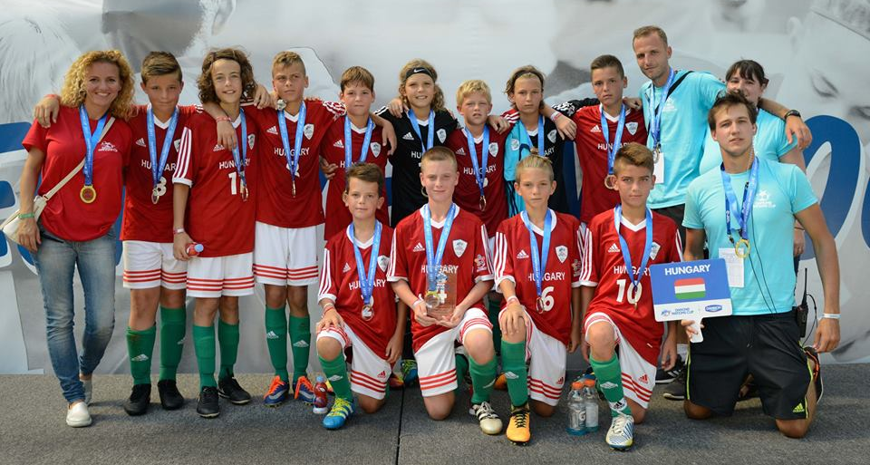
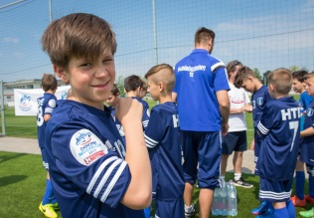
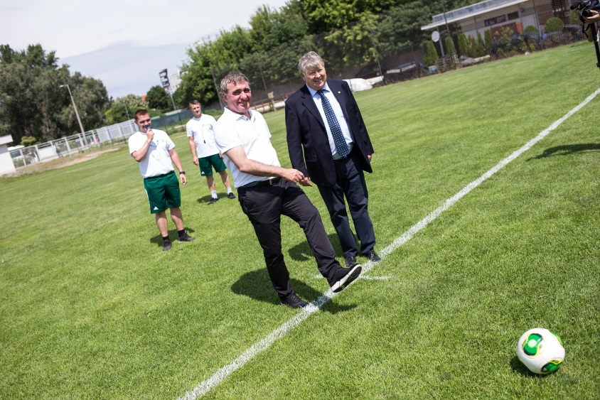
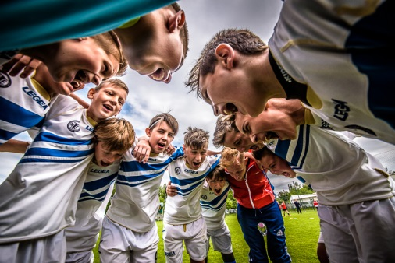
DNC Hungarian tournament 2017

Slide 5
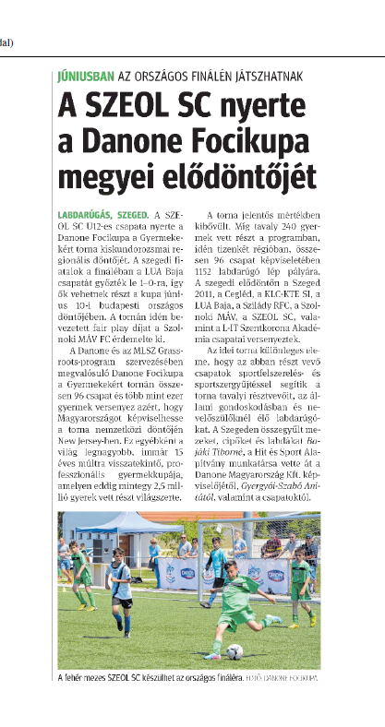
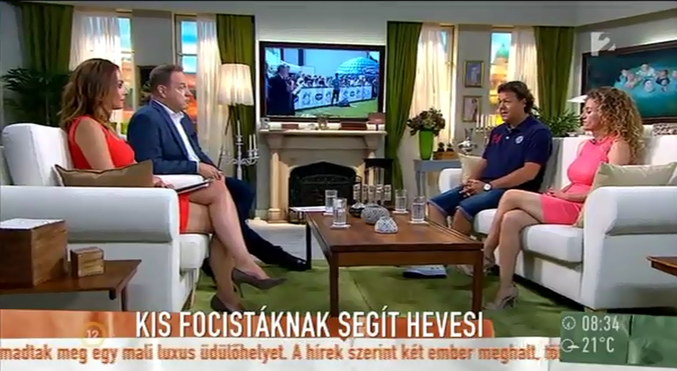
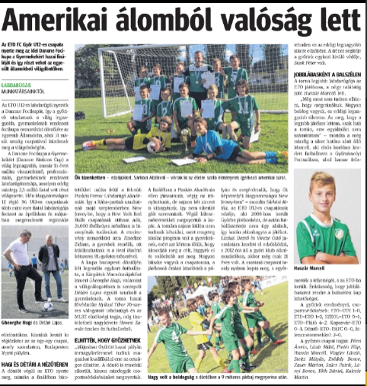
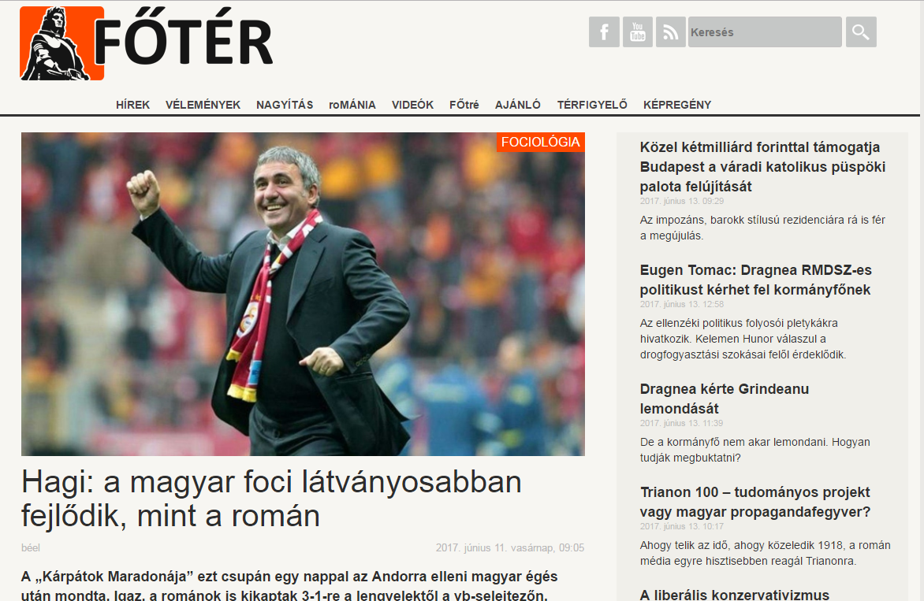
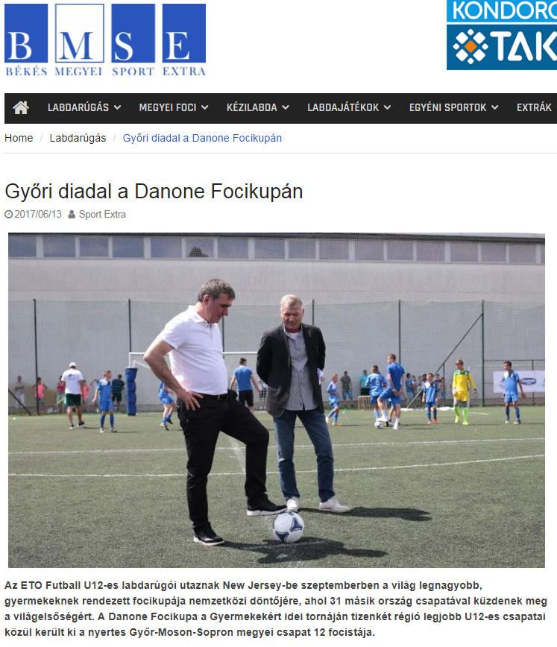
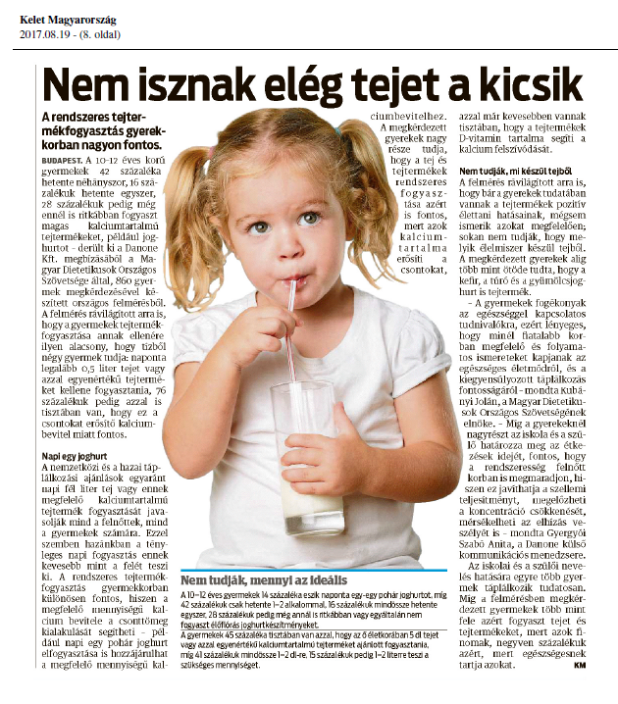
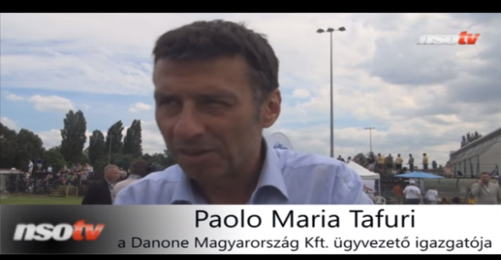
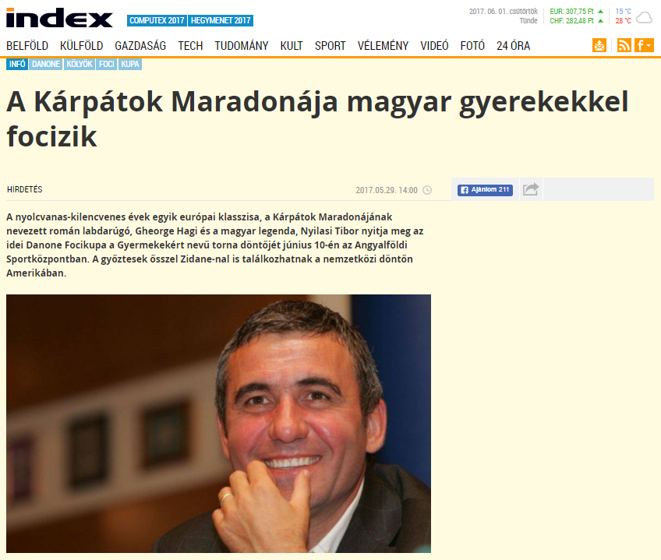
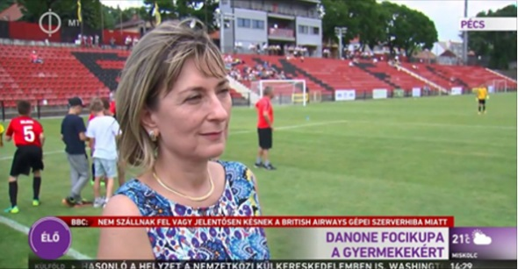
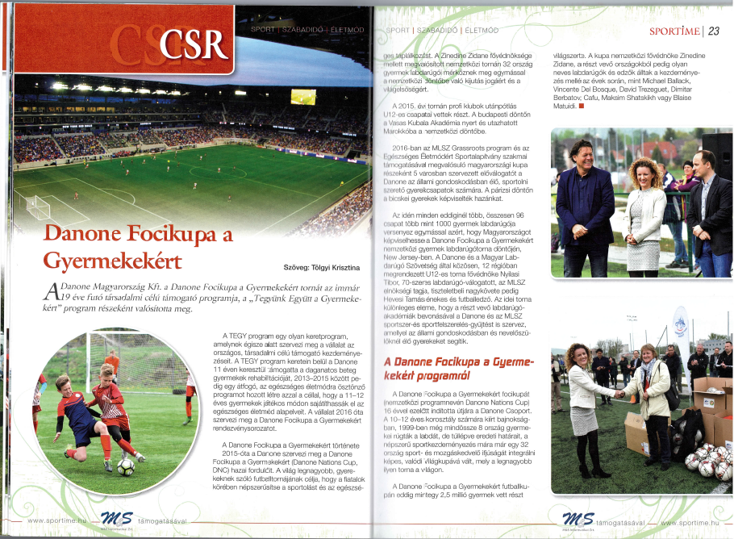
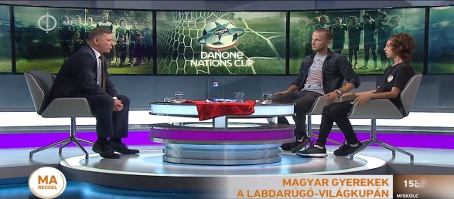
Media appearances 2017

Slide 6
DNC Hungary 2018

Slide 7
DNC 2018
UMBRELLA CONCEPT
DANONE HEALTHY FAMILY DAY
(Danone Egészséges Család Napja)
Event
CSR
Activation
What?
Health & Sport Family Day
Elements:
Nutrition advice by MDOSZ
BMI, Screening for families & kids
Health games & challenges
Yoghurt tasting
Why?
Help healthy life of families & kids
(2018: Year of Families)
CSR partner:
Association of Large Families
How?
Nutrition education video films
Nutrition education quiz
Donation for CSR

Slide 8
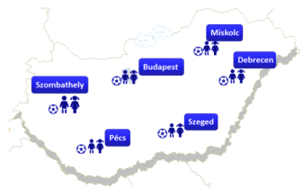
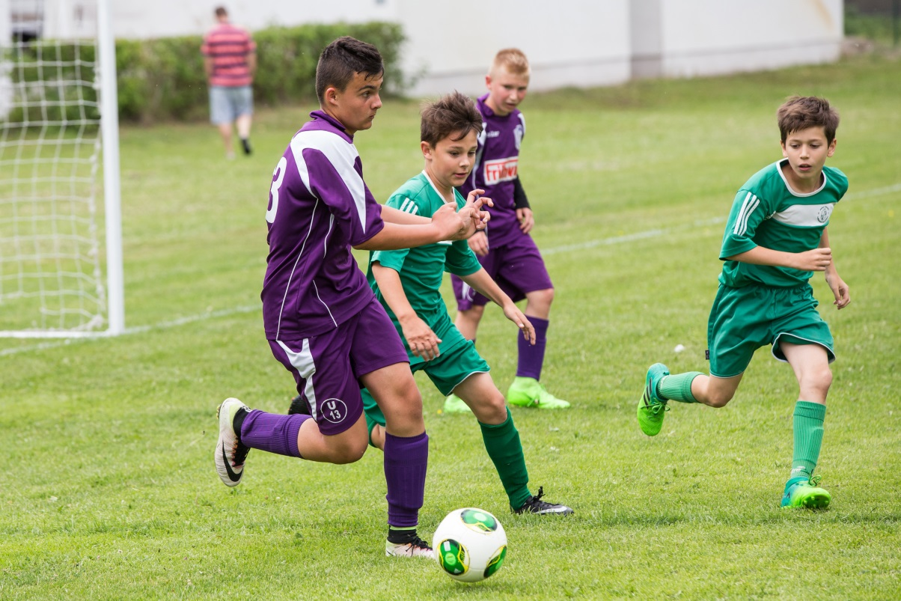
THE TOURNAMENT
Cooperation with MLSZ
Grassroots Program of the Hungarian Football Federation
The tournament:
Dates of 4 regional semi-finals confirmed by MLSZ
June 3., Pécs – 16 teams
June 3., Szeged – 16 teams
June 9., Miskolc – 16 teams
June 9., Debrecen – 16 teams
1 national final
June 17., Budapest – 12 teams
National final:
One day tournament with 12 teams in Budapest

Slide 9
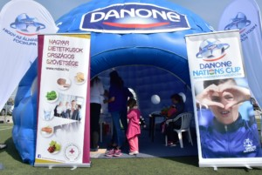
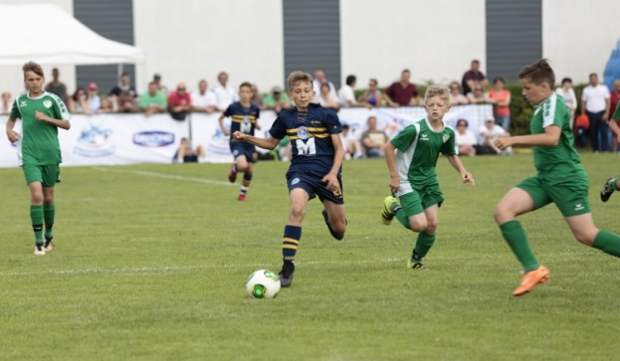
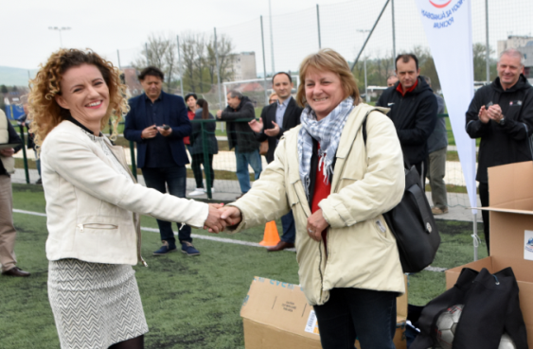
The events
Nutrition & health education:
Nutrition advice from MODOSZ
BMI measurement, screening
Nutrition quizzes (via FB)
Smart plate
Sport :
DNC matches
Media opening on site
Kick off by Danone and local stakeholder
Donation handover:
4x200.000 HUF donation for National Association of Large Families

Slide 10
STAKEHOLDERS, ENDORSERS
National Ambassador
DNC National Patron
Tibor Nyilasi
Ministry of Human Capacities
Debrecen
Miskolc
Pécs
Szeged
Hungarian
Football Federation
Association of
Hungarian Dietitians
Association
of Large Families

Slide 11
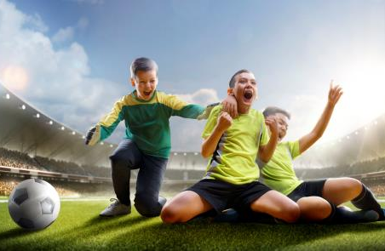
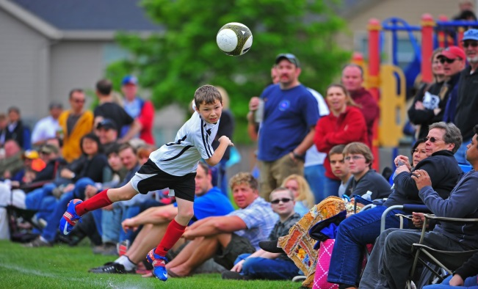
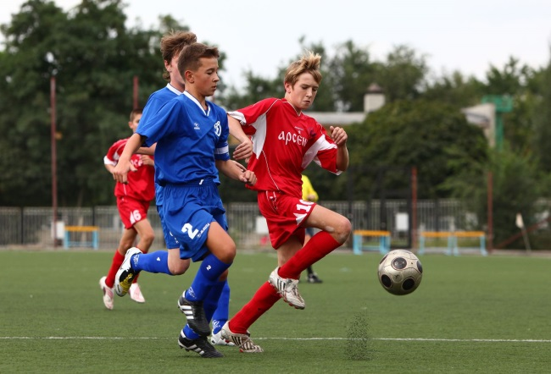
CUP STRUCTURE
1 team
12 children
(next year)
Inter-
National Final
12 teams
144 children
National Final
Regional Semi-Finals
4 regions
4 x 16 teams
800 to 1000 children
1.
2.
3.
4.

Slide 12
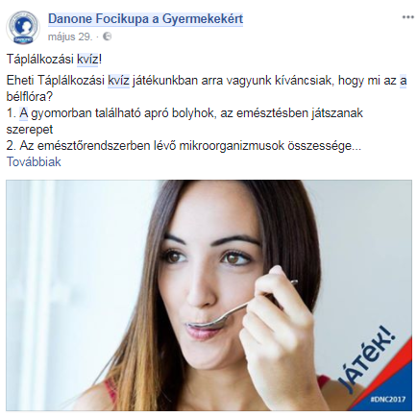
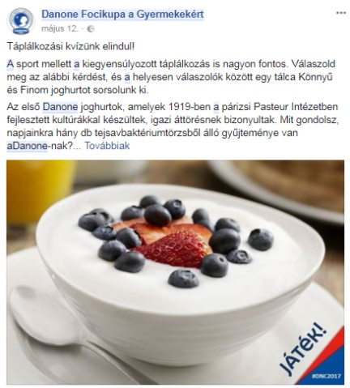
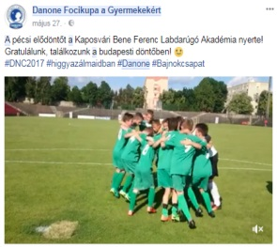
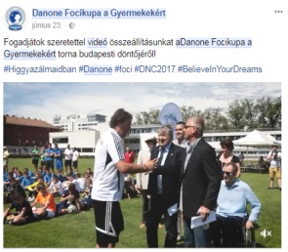
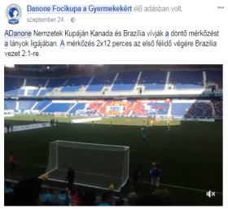
SOCIAL MEDIA
Ongoing social media management
Continuous quizzes about nutrition
On the DNC FB page
Prizes:
Danone products
Continuous update about the program
Nutritional videos & quizzes
Nutrition tips and advice
Presentation of the children involved
Interview with the ambassadors
Interview with children

Slide 13
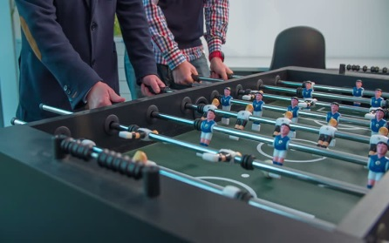
EMPLOYEE ACTIVITATION
ANITA TO ADD

Slide 14
Thank You for your attention

